Slide 1
Complex Event Modelling in Elasticsearch
Nesting

Slide 2
Presentation Purpose
This presentation assumes that you are aware and want to take advantage of the elasticsearch featureset. E.g.
Functional features - match queries, common terms queries, synonyms, search templates, scroll, custom scoring, percolate queries, more like this queries, etc….
Non Functional features - fast search, cluster management, container compatible.
However your events are complex so you are not sure how to configure elasticsearch to support your use case.

Slide 3
Background On Our Requirements
Data holdings growing by 100+ million events each year.
Data streaming in from over 1,300 entities with different levels of sophistication.
The event details captured both in terms of types and content are vastly different based on the entity submitting the data.
No registry of entities to match the parties on the incoming data feed.
Significant effort is required to standardise and embellish reported data before its is made available for analysis. The standardisation and embellishment processing is constantly evolving, and when changes are made these changes are required to be applied to all historical data.
Thus the search datastore is required to be reloaded from scratch on a regular basis.
Notes:
Highlight that the above approach ensures that searches are performed against a consistently enhanced data set (historical approaches only enhanced new data with new processing logic which obviously results in inconsistent search results).

Slide 4
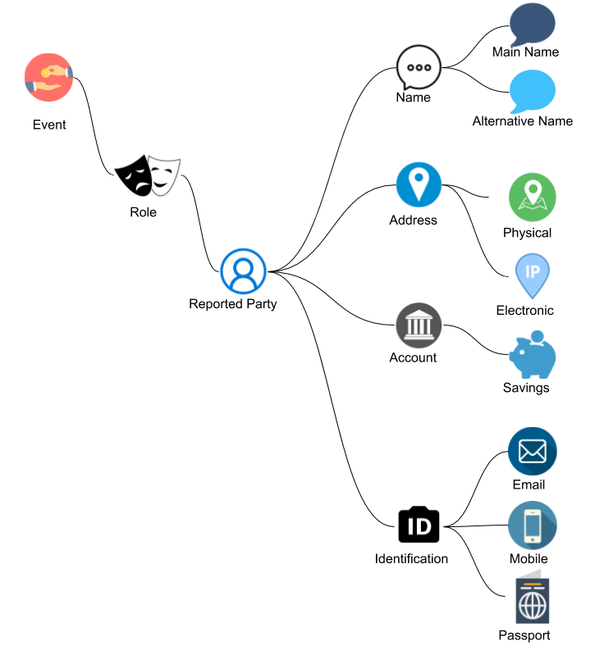
Our Product Model
Reported events are deeply nested with every level of the hierarchy a repeating group. I.e.
Multiple Roles within an Event
Multiple ReportedParties within a Role
Multiple Names within a Party
Multiple Addresses within a Party
Multiple Accounts within a Party
Multiple Ids within a Party
Analysis is required to be supported at every level of the hierarchy.
Notes:
Data model is so generic as reported data covers many different use cases.
Maybe mention -- > events have an average of 4 different reported parties

Slide 5
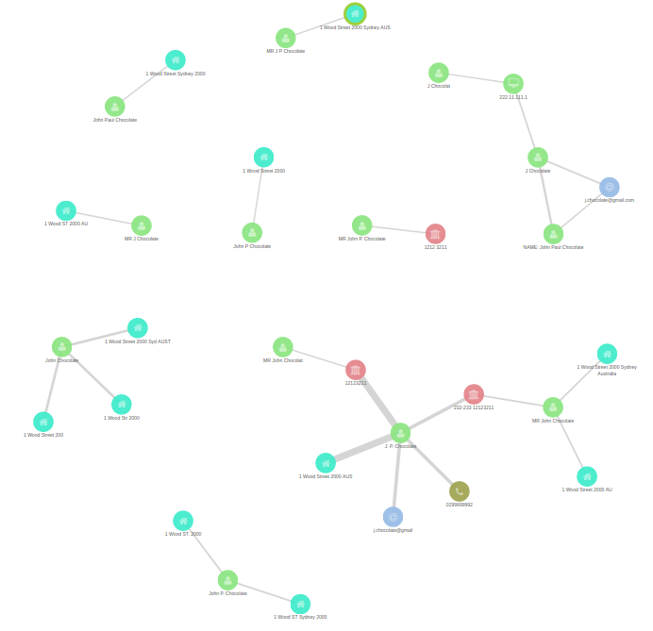
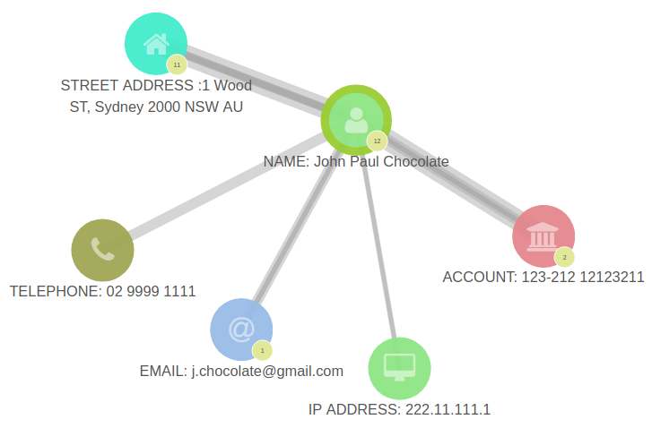
Absence of Unique Keys (lots of fuzzy linkages)
Notes:
Absence of unique keys/reference dataset means that reported data on the left of the screen is actually the single real world entity with only a few truly unique characteristics.
If your data has a persistent unique Id - your very lucky :)

Slide 6
How to Model This Data
Historical approaches included;
Normalised database structures (relational tables). However did not scale as transactional integrity is required to be maintained.
De-normalised database structure (flat or partially flat table). However resulted in ultra wide rows leading to complex queries and aggregations of search results.
With some elasticsearch configuration we were able to model all of complexity of the data into a single index that addressed the above limitations.
To do this we needed to leverage a nesting mapping …….

Slide 7
Elasticsearch Mapping
A mapping is just elasticsearches’s terminology for a schema.
Default Mapping → where no mapping is pre-configured elasticsearch applies a simple schema to the data which stores nested fields as a list (which will meet some requirements).
Pre-configured Mapping → a pre-configured nested mapping supports more complex searching by storing each repeating group separately.
name | Address
Lilly Smith | 111 First RD Firstville, 222 Second ST Secondville
{
"name": "Lilly Smith"
},
{
"address": "111 First RD Firstville"
},
{
"address": "222 Second ST Secondville"
}
Default mapping
name | Address
Lilly Smith
 | 111 First RD Firstville
 | 222 Second ST Secondville
Nested mapping
Notes:
Highlight that the default mapping results in a search for “111 First ST Secondville” being a hit - it’s a cross match between half the two addresses. Mappings support lots of other configurations e.g. data types, custom tokenisers, analyzers, multi-fields, etc…. Not mentioned above.

Slide 8
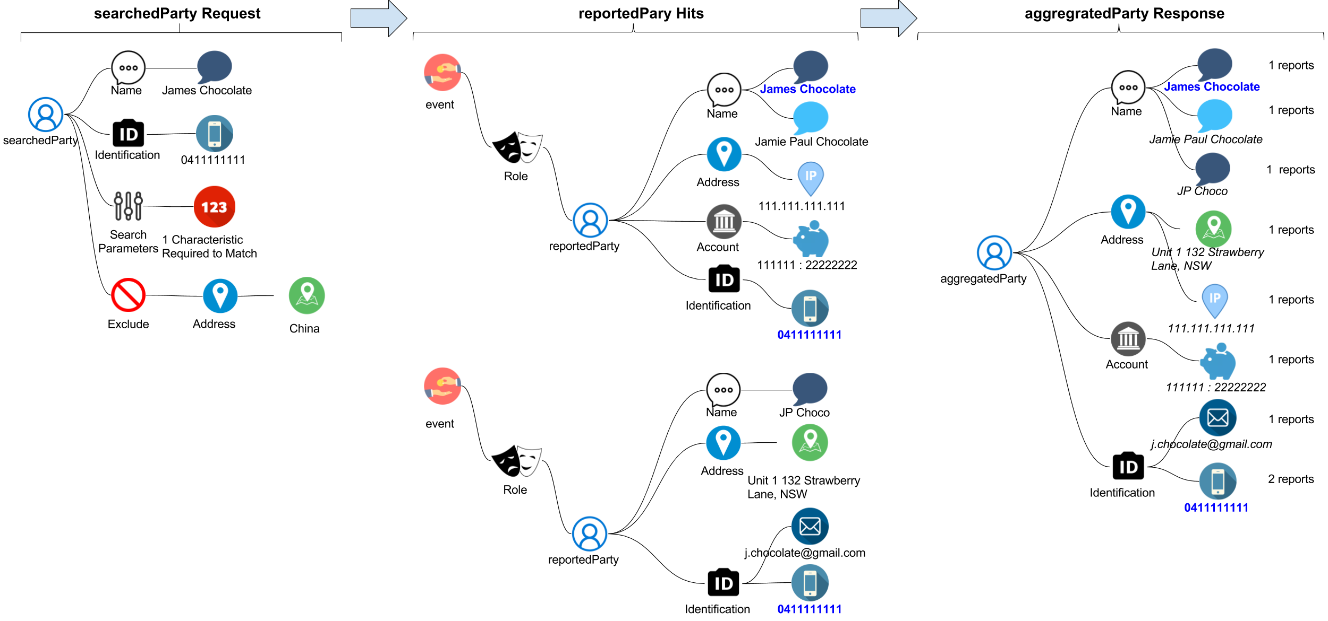
partySearch
With a nested index we can perform searching and aggregration on each level of the heairahcary.
The example to the right shows how you can search reported parties with specific characteristics and return aggregated results.
Notes:
Example Explanation;
The searchedParty in this example has;
Two supplied characteristics (name and telephone number),
A search parameter indicating that only one of the characteristics supplied is required to match (changing this to two would significantly improve the confidence of any matches however in this example would have led to no hits)
An exclusion of all parties with an address country of China
Two reported parties hit this search query and their characteristics are aggregated before the response is supplied to the user.
Key Points in relation to searching :
You have full access to elasticsearch features (e.g. boolean matching, minimum should match, common query, search time synonyms, etc...) when performing a partySearch. Different search templates or parameters in a single template can be setup based on different use cases. E.g.
Large volume / low value searches when the results are not going to be reviewed manually but need to provide high quality hits.
Low volume / high value searches when the results will be reviewed manually and the focus is ensuring no possible matches are missed.
At the point of finding hits you have full access to all of the transaction and role details for a reportedParty. So you can choose to include or exclude parties based on;
The role of the party played,
The type / direction of the transaction,
The address of the party (as in the example above),
Date of the transaction (e.g. exclude address hits that were greater than 3 years ago).
Key Points in relation to aggregation
The above graphic illustrates the aggregation the number of events per attribute however it is also possible to calculate other aggregations for each characteristic as well as for the aggregated party (e.g. total value of events by event type) - this uses reverse nesting - climbing back up the hierarchy.

Slide 9
Elasticsearch Experiences to Share
Based on our configured mapping data storage reduced by just over 50% with the move from elasticsearch 5.5.1 to 6.rc.1.
Never provide access to Kibana without configuring the breaker settings.
Set the Kibana queryString:options to have a default_operator of AND. This is how business people expect that kibana search bar to work.
Consider using a combination of spinning and SSD hosts in your production cluster with replicas on each (then review the preference search request setting) - hopefully saving you some cash.
Things are changing pretty fast so you really need to keep an eye on the elastic blog to see what’s coming down the line.

Slide 10
Conclusion
Slides and nested worked example can be found here → https://github.com/swarmee/partySearch
Good Luck !

